Slide 1
Software Engineering Lab
Building a blog web application
Lakehead university
Department of Computer Science
COMP-3415 - Software Engineering
Presented by: Gad Gad

Slide 2
Outline
Project overview
Project structure
Front end
Back end
Database
User authentication
Demo

Slide 3
Project overview
Features:
User interface
User authentication
Database
Languages and Tools:
Front end
HTML
CSS
Back end
Python (Flask, SQLite)

Slide 4
Project structure
├── flaskr/
│ ├── __init__.py
│ ├── db.py
│ ├── schema.sql
│ ├── auth.py
│ ├── blog.py
│ ├── templates/
│ │ ├── base.html
│ │ ├── auth/
│ │ │ ├── login.html
│ │ │ └── register.html
│ │ └── blog/
│ │ ├── create.html
│ │ ├── index.html
│ │ └── update.html
│ └── static/
│ └── style.css
Flask is flexible and does not require a specific project structure. However, this project uses a common Flask structure for a project that’s easy to expand on.

Slide 5
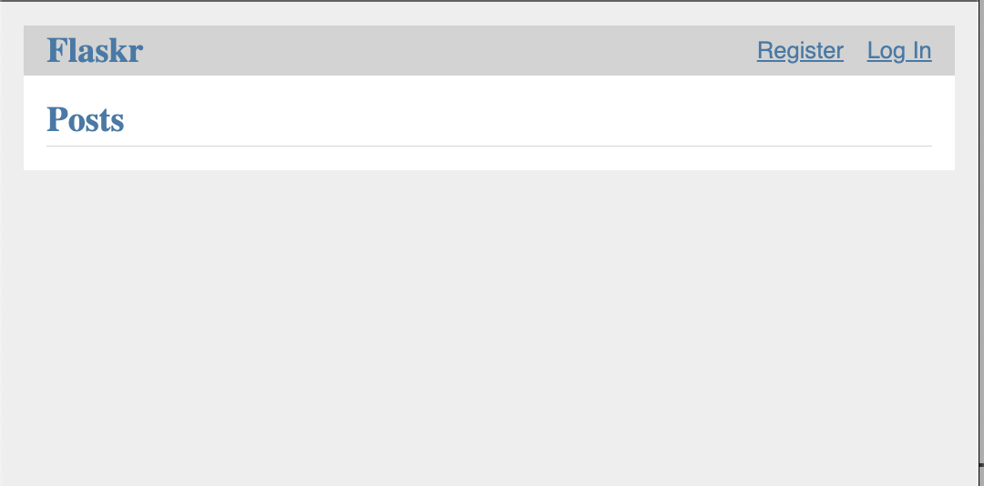
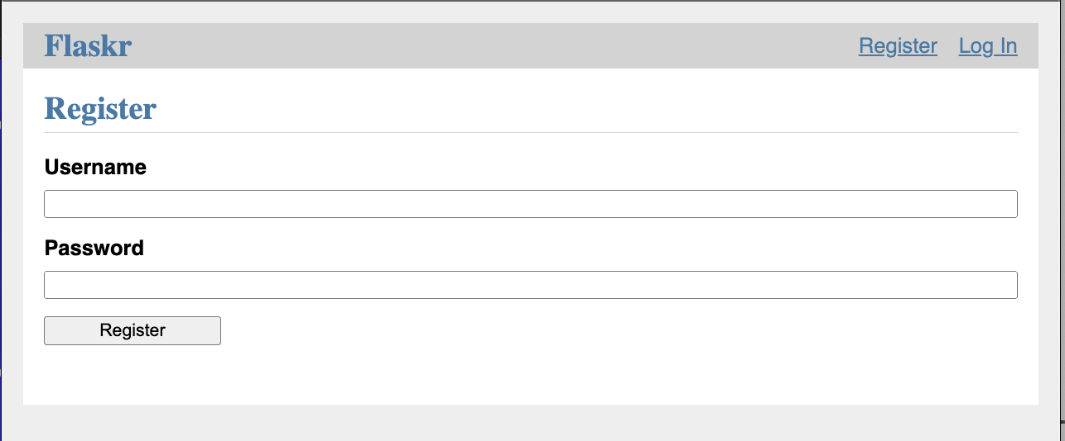
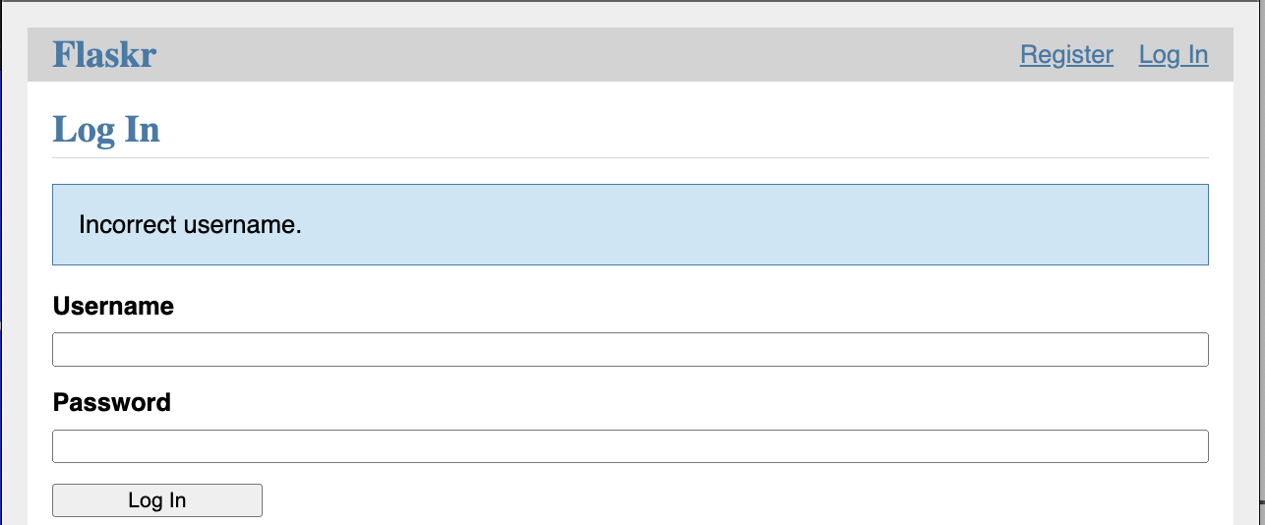
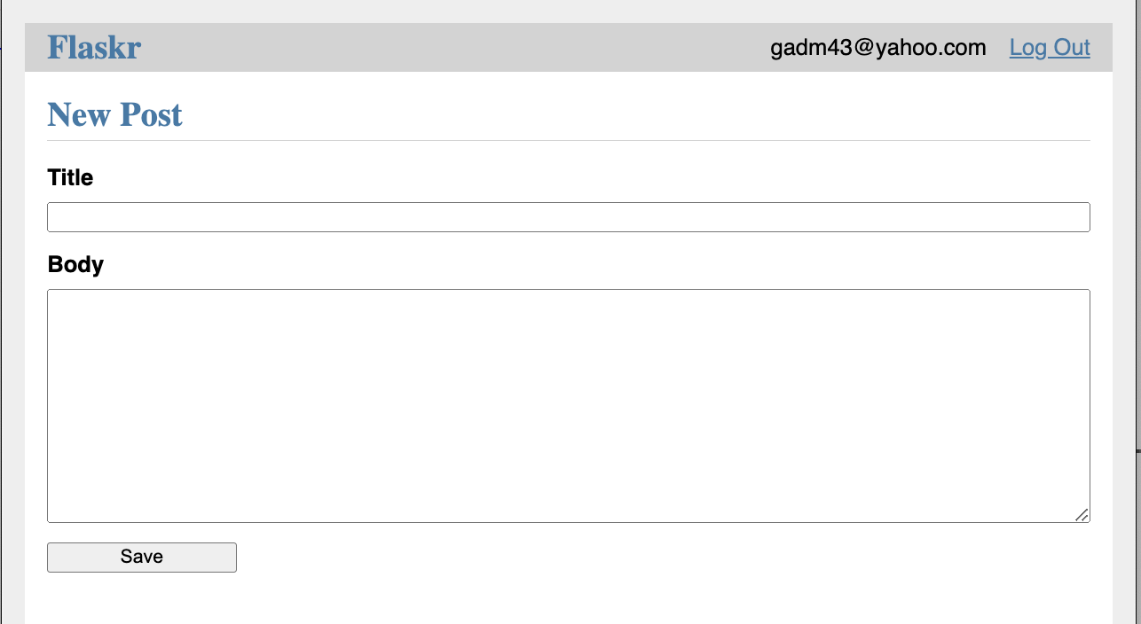
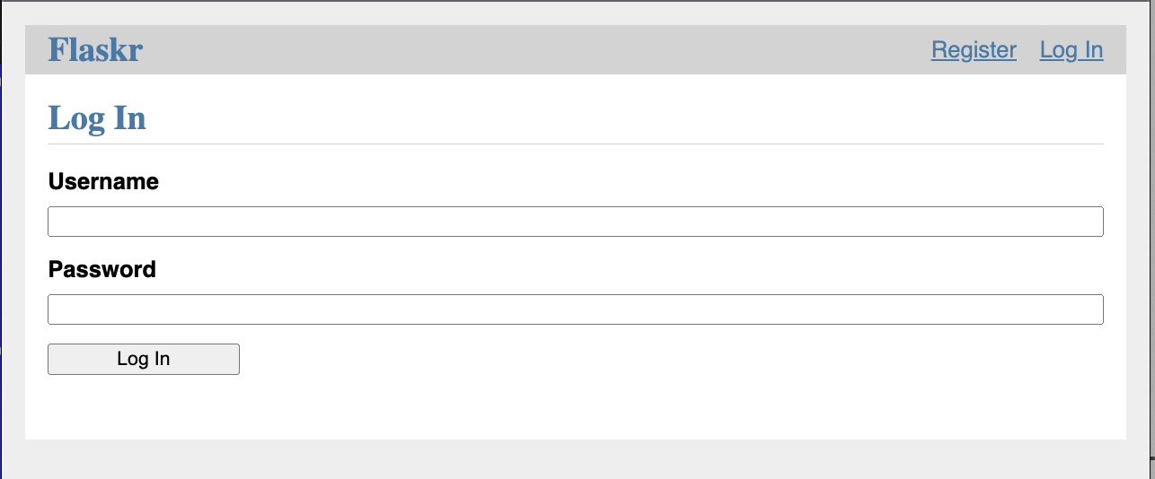
Front End
The front end of this project includes multiple HTML files each is associated with a flask route function to associate the back end logic to it. These html files are stored inside the templates folder inside the flaskr application folder.
Flask uses Jinja to embed and render python-like code in HTML. This code makes it easy to make different variations/views from a base html file

Slide 6
Back end - Factory function
The factory function is one of Flask design patterns to create a Flask web application.
The __init__.py file serves to tell python that flaskr is a package, and the create_function inside it is a Flask factory function that:
1- Creates a Flask application
2- Registers blueprints
3- Configures the SQL database
def create_app(test_config=None):
app = Flask(__name__, instance_relative_config=True)
app.config.from_mapping(
SECRET_KEY="dev",
DATABASE=os.path.join(app.instance_path, "flaskr.sqlite"),
)
db.init_app(app)
app.register_blueprint(auth.bp)
app.register_blueprint(blog.bp)
return app

Slide 7
Back end - Database
The application uses SQLite database through the sqlite3 python library to store users and posts according to the following schema
SQLite is simple and convenient for small application.
To access a database, you have to first connect to it. This connect is usually related to a request.
We also need to register the init_db CLI command and the DB closing procedure at the end of handling coming requests:
CREATE TABLE user (
id INTEGER PRIMARY KEY AUTOINCREMENT,
username TEXT UNIQUE NOT NULL,
password TEXT NOT NULL
);
CREATE TABLE post (
id INTEGER PRIMARY KEY AUTOINCREMENT,
author_id INTEGER NOT NULL,
created TIMESTAMP NOT NULL DEFAULT CURRENT_TIMESTAMP,
title TEXT NOT NULL,
body TEXT NOT NULL,
FOREIGN KEY (author_id) REFERENCES user (id)
);
def init_app(app):
app.teardown_appcontext(close_db)
app.cli.add_command(init_db_command)

Slide 8
Back end - Authentication
Built-in blueprint-based decorator
Create a decorator
Before serving any request that require authentication, copy user_id from session to g
Redirects user to login view for certain requests that require authentication
@bp.before_app_request
def load_logged_in_user():
"""If a user id is stored in the session, load the user object from
the database into ``g.user``."""
user_id = session.get("user_id")
if user_id is None:
g.user = None
else:
g.user = (
get_db().execute("SELECT * FROM user WHERE id = ?", (user_id,)).fetchone()
)
def login_required(view):
"""View decorator that redirects anonymous users to the login page."""
@functools.wraps(view)
def wrapped_view(**kwargs):
if g.user is None:
return redirect(url_for("auth.login"))
return view(**kwargs)
return wrapped_view

Slide 9
Back end - Blueprints and views
Our Flask blog app will have two blueprints: auth and blog, for authentication functions and blog posts functions. A blueprint is similar to an application. It has a name, groups related views, and its name is prepended to its associated routes making it easier to deal with and expand on.
Use the Blueprint
@bp.route("/<int:id>/delete", methods=("POST",))
@login_required
def delete(id):
"""Delete a post.
Ensures that the post exists and that the logged in user is the
author of the post.
"""
get_post(id)
db = get_db()
db.execute("DELETE FROM post WHERE id = ?", (id,))
db.commit()
return redirect(url_for("blog.index"))
Create a Blueprint for auth
bp = Blueprint('auth', __name__, url_prefix='/auth')
Register the Blueprint to the app
def create_app():
app = ...
# existing code omitted
from . import auth
app.register_blueprint(auth.bp)
return app

Slide 10
DEMO
Code available at https://github.com/gadm21/Flask-Blog-application

